Slide 1
Fundamental Frequency (F₀) Detection

Slide 2
Speech Source Model
Sophisticated model for speech production
Simplified model for speech production
Voiced
Pitch period, N
G
Periodic Impulse
Train Generator
G(z)
Glottal
filter
V
H(z)
Vocal Tract
Filter
R(z)
Lip
Radiation
Filter
x(n)
Speech
Signal
Uncorrelated
Noise
Generator
U
G
Unvoiced
Pitch period, N
Voiced
Periodic Impulse
Train Generator
Voiced/unvoiced
switch
V
Combined
Filter
x(n)
Speech
Signal
Random
Sequence
Generator
U
G
Unvoiced

Slide 3
Simplified Speech Source Model
unvoiced
voiced
G(z), G(ω), g[n]
random
sequence
generator
G(z) =
x[n]
×
u[n]
1
1− ∑ a_{k}z^{-k}
P
k = 1
periodic pulse train
generator
G
v/u
Vocal Tract Model
N
Excitation
  Excitation parameters
  v/u : voiced/ unvoiced
  N : pitch for voiced
  G : signal gain
  → excitation signal u[n]
  Vocal Tract parameters
  {a_{k}} : LPC coefficients
  →formant structure of speech signals
  A good approximation, though not
  precise enough

Slide 4
Fundamental Frequency Utilization
Speech synthesis – Prosody Modeling.
Speech Recognition
Speech coding
Voice conversion
Spoken language learning

Slide 5
Fundamental Frequency Characteristics
F0 takes the values from 50 Hz (males) to 400 Hz (children)
→If Fs=8000 Hz these frequencies correspond to the lags L=160 to 20 samples. It can be seen, that with low values F0 approaches the frame length 20 ms, which corresponds to 160 samples
The difference in pitch within a speaker can reach to the 2:1 relation.
Speech is called quasi periodic signal small changes between the period. These small shifts are called “jitter”
F0 is influenced by many factors – usually the melody, mood, distress, etc.

Slide 6
Issues in Fundamental Frequency Detection
Purely voiced or unvoiced excitation does not exist either. Usually, excitation is compound (noise at higher frequencies).
Speech is called quasi periodic signal
Difficult estimation of pitch with low energy.
High F0 can be affected by the low formant F1 (females, children).
During transmission over land line (300–3400 Hz) the basic harmonic of pitch is not presented but its folds (higher harmonics).

Slide 7
Time Domain Methods
Zero-Crossing Detection
Autocorrelation Function
Average Magnitude Difference Function

Slide 8
Zero-Crossing Detection based F0 detection
Based on a direct application of the definition of periodicity
Counting the number of time that the signal crosses a reference level
If the spectral power of the waveform is concentrated around F₀, then it will cross the zero line twice per cycle
Mostly Inexpensive in computation
Weakness against noise
Presents weakness when used to analyze signals with energy in high frequencies

Slide 9
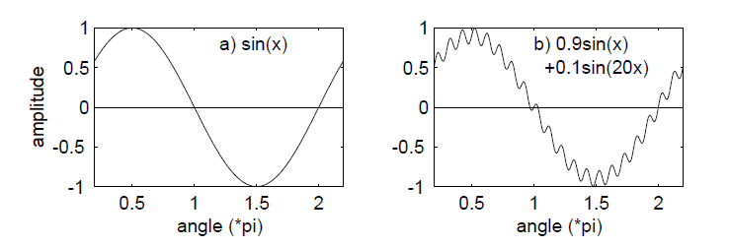

Slide 10

Autocorrelation Technique
Autocorrelation is a cross-correlation of a signal with itself.
  The maximum of similarity occurs for time shifting of zero.
  An other maximum should occur in theory when the time-shifting of the signal corresponds to the fundamental period.

Slide 11
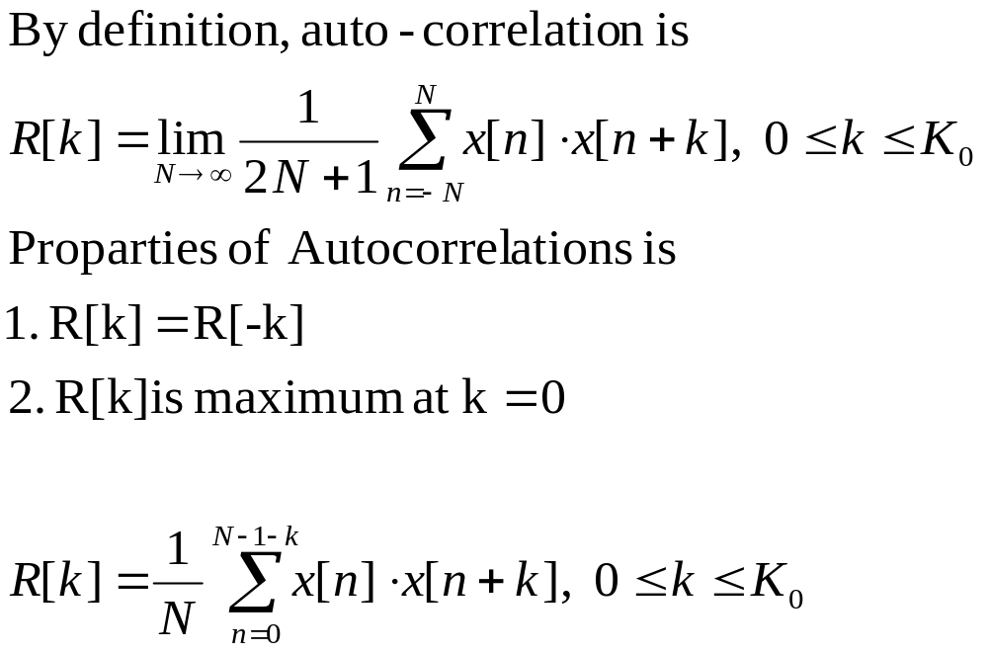
Autocorrelation function
Ch4. pitch, v3.a

Slide 12
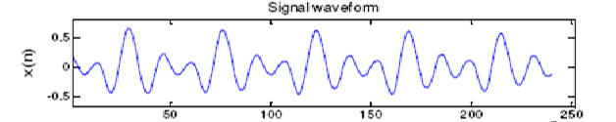
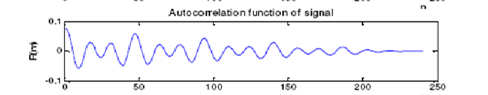
T₀
2T₀
3T₀
When a segment of a signal is correlated with itself, the distance (Lag_time_in_samples) between the positions of the maximum and the second maximum is defined as the fundamental period (pitch) of the signal.

Slide 13
The result can be enhanced by
Center clipping
Using cross-correlation
Filtering the speech signal
  Pitch range is 40 – 400 Hz (40-200 Hz for male, and 200-400 Hz for female)

Slide 14
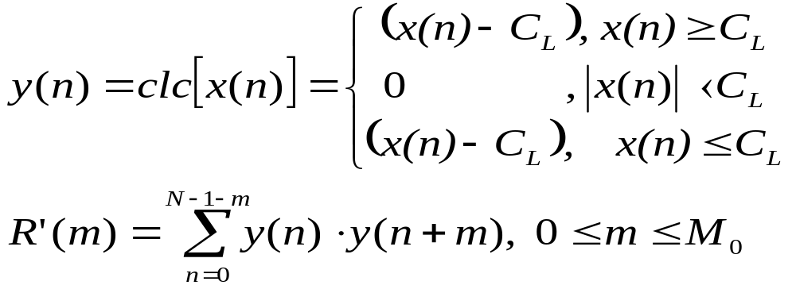
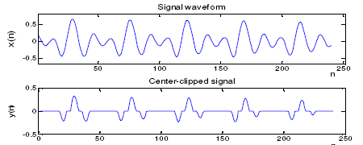
Center clipping
Typical C_{L} =1/4 peak-to-peak of X

Slide 15

Clipping Level Value Estimation
As a speech signal s(n) is a non-stationary signal, the slipping level changes and it is necessary to estimate it for every frame, for which pitch is predicted. Simple method is to estimate the clipping level from the absolute maximum value in the frame:
Where the constant k is selected between 0.6 and 0.8.
Further, subdivision into several micro-frames can be done, for instance x1(n), x2(n), x3(n) of one third of the original frame length. The clipping level is then given by the lowest maximum from the micro-frames:
Issue: clipping of noise in pauses, where subsequently can be detected pitch. The method therefore should be preceded by the silence level s_{L} estimation. In the maximum of the signal is < s_{L}, then the frame is not further processed.

Slide 16
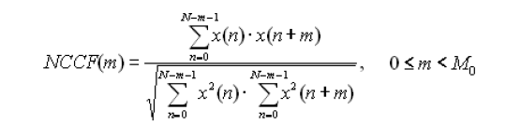
Normalized cross correlation function (NCCF) method
The normalized cross correlation function (NCCF) is very similar to the autocorrelation function, but is better follows the rapid changes in pitch and the amplitude of speech signal.
The NCCF based PDA overcomes most of the shortcomings of the autocorrelation based algorithms at a slight increase in computational complexity.
The NCCF function for speech segment x(n), 0 ≤ n ≤ N-1 is defined

Slide 17
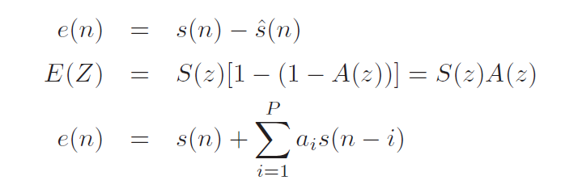
Utilization of the Linear Prediction Error
The signal e(n) contains no information about formants, thus is more suitable for the estimation. Lag estimation from the error signal can be done using the ACF method

Slide 18
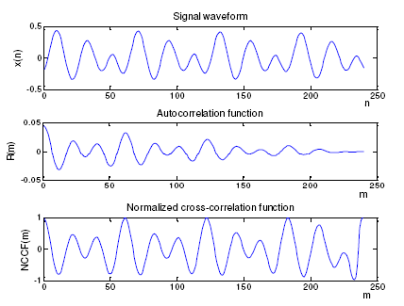

Slide 19
Autocorrelation Technique
  Not very efficient for high fundamental frequency.
  Convolution is a very expensive process.
  Computation efficiency can be improved using the FFT algorithm instead of convolution. It reduces calculation from N squared to N log₂N.
  Most of the variation of this technique related to the mathematical definition of the autocorrelation used, the way the maximums are localized, and how errors in the maximum identification are attenuated.

Slide 20
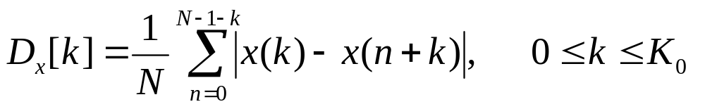
Average Magnitude Difference Function(AMDF)
It is an alternate to Autocorrelation function.
It compute the difference between the signal and a time-shifted version of itself.
  While autocorrelation have peaks at maximum similarity, there will be valleys in the average magnitude difference function.

Slide 21
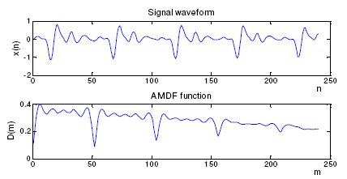

Slide 22
Less computational complex so suitable for H/W implementation
Performance is poor and it does not cater for variation in the energy of the speech

Slide 23
Other Temporal Algorithm
Waveform Maximum Detection
Sum Magnitude Difference Squared Function
Average Squared Difference Function
Cumulative Mean Normalized Difference Function
Circular Average Magnitude Difference Function
Adaptive Filter

Slide 24
Frequency Domain Pitch Detection Algorithms (PDAs)
Frequency domain PDAs operate on speech spectrum.
Distance between harmonics is the fundamental frequency, or inverse of the pitch period.
Main drawback of frequency domain PDAs is high computational complexity.

Slide 25
Frequency Domain Pitch Detection Algorithms (PDAs)
Two kinds of frequency PDAs are:
  Harmonic Peak Detection
  Spectrum Similarity

Slide 26
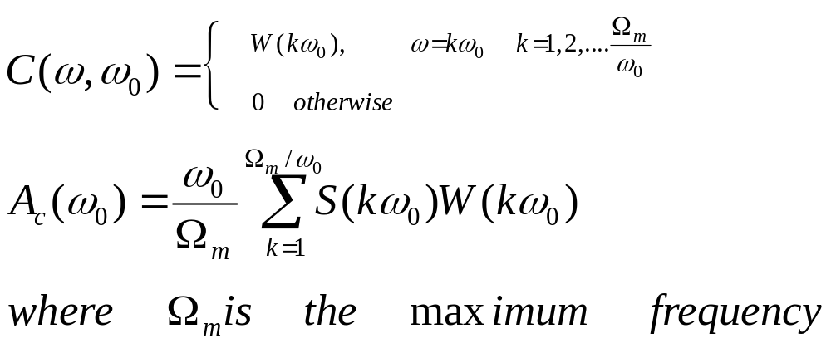
Harmonic Peak Detection
Detect all harmonic peaks.
Get the fundamental frequency by recognizing it as the common divisor or the spacing of adjacent harmonics.
This can be done using a comb filter.

Slide 27
Spectrum Similarity
Assumes that the spectrum is fully voiced and is composed only of harmonics located at multiples of the pitch frequency.
Synthetic spectrum is created from each frequency candidate and compared to original spectrum.
Best one to match the original spectrum is selected as the fundamental frequency.

Slide 28

Time and Frequency Domain PDAs
Combine results from time domain algorithms and frequency domain algorithms to provide a better pitch estimate.
E.g. Autocorrelation for time and frequency domain is given by :

Slide 29
Voiced/Unvoiced Classification
Periodic Similarity
Peakiness of Speech
Zero Crossing
Spectrum Tilt

Slide 30
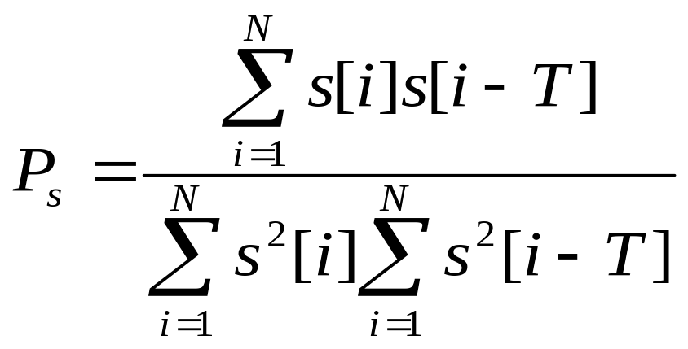
Periodic Similarity
Most prominent characteristic that separates voiced speech from unvoiced speech is its regularity and fairly well-defined pitch.

Slide 31
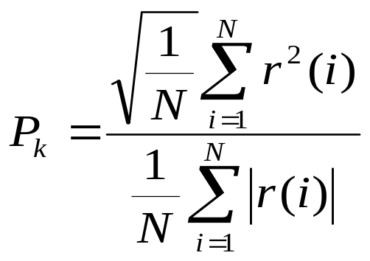
Peakiness of Speech
Voiced speech contains regular pulses which do not appear in unvoiced speech.
Unvoiced speech, however, may contain a few random spikes and in these cases, those frame may be incorrectly labeled as voiced.
LPC residue is used to compute its value

Slide 32
Zero Crossing
Number of times unvoiced speech crosses the zero line is significantly higher than that of voiced speech.
Gender of speaker can also have an effect on zero crossing.
Small pitch weighting can be used to weight the decision threshold.

Slide 33
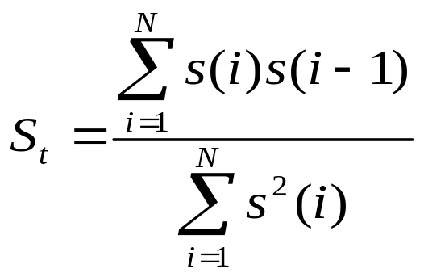
Spectrum Tilt
Voiced speech has higher energy in low frequencies and unvoiced speech has higher energy in high frequencies.
Can avoid individual spikes in low-level signals.

